Slide 1

Real Time Analysis of Bank Customer
- Priyansh Kumawat

Slide 2

PROBLEM STATEMENT
Analyzing the demographic and financial profiles of bank customers to identify key trends and insights that can drive strategic decision-making for customer retention, targeted marketing, and service improvement.

Slide 3
Project Description
Demographic Analysis:
Understand the distribution of customers by age, gender, and region.
Identify any significant demographic trends or patterns.
Financial Behavior Analysis:
Analyze the distribution of account balances.
Determine average and median balances to gauge the overall financial health of the customer base.
Employment Profile Analysis:
Examine the distribution of customers across different job classifications.
Identify any correlations between job classification and account balance.
Customer Acquisition Trends:
Track the number of customers joining over time.
Identify any trends or spikes in customer acquisition to inform marketing strategies.
Comprehensive Insights:
Explore correlations between demographic factors (age, gender, region) and financial metrics (account balance).
Identify key customer segments with high balances or significant growth potential.

Slide 4

WHO ARE THE END USERS?
Bank Executives and Senior Management
Marketing and Sales Teams
Customer Relationship Managers
Product Development Teams
Business Analysts and Data Scientists
Risk Management and Compliance Teams
Product Managers

Slide 5

Technology Used
Microsoft excel: Data Cleaning , Data Interpretation
Power Query : Data Transformation
Power BI : Data Visualization , Insights Generation.

Slide 6
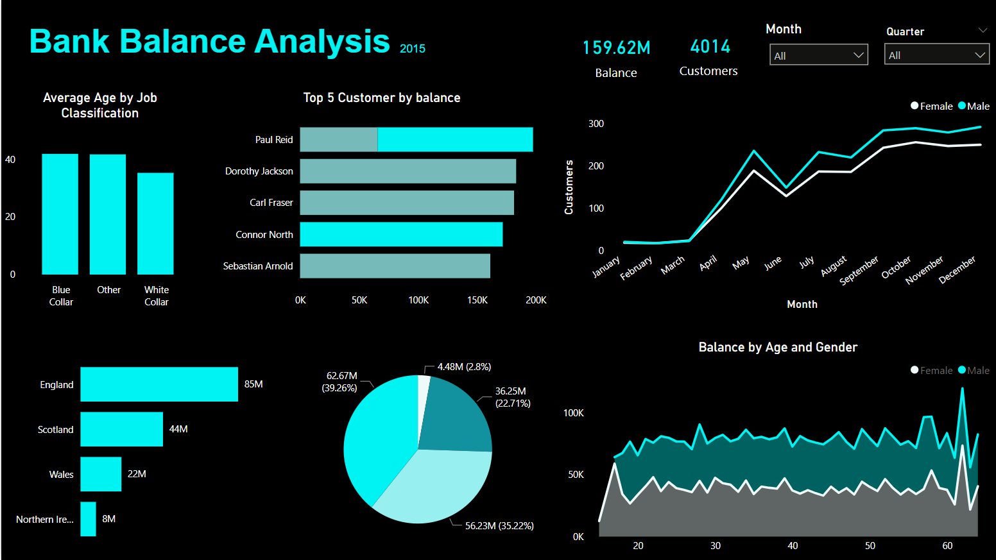
Dashboard
Demo Link

Slide 7
Potential Insights for year 2015
Male Customers hold more balance than female customers .
Customers with age between 35-40 are most active and hold more money in their account so customers apart from them can be taken into consideration like potential scheme targets.
Customers in England hold around 85M $ in their account , maximum in the neighbouring region. They can be considered as the most trusted and profitable customers for bank.
White collar customers hold most amount of money , around 78M $ highest then other job professions , but the average balance of most of the job professions are around 70K $.
Bank was able to increase the number of customers from 47 in the month of March to 542 till the end of year , this was the increase of almost 1053% . This also help to gain more belief into customer to store their money safely in bank.
Quarter 3 and 4 were the best from the balance accumulation point of view where 3rd Quarter collected 56.23M $ (35.22%) and 4th Quarter collected 62.67M $ (39.26%).
In this year Paul Reid was our top customer with balance of around 200K $ in his England and Scotland account combined. Dorothy Jackson was 2nd with 180K $ in his Scotland Account.
.
.
Thank You

